Slide 1

TECH WIZARDS
IBM CALL FOR CODE COMPETITION 2022
GLA University, Mathura, Uttar Pradesh, India

Slide 2

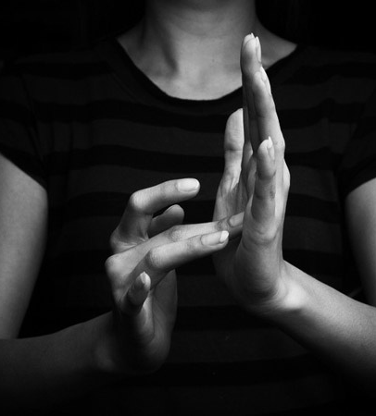
Sign Language Recognition with Machine Learning

Slide 3
ASL
13.1%
PROBLEM STATEMENT
WHY?
1%
5%
Deaf or Mute
ASL
466 Million
70 Million
Deaf or Mute
86.9%

Slide 4

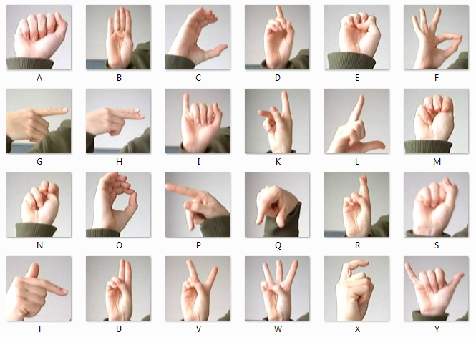
SIGN LANGUAGE MNIST DATASET
Inspired by the Fashion-MNIST 2 and the machine learning pipeline for gestures by Sreehari 4.

Slide 5
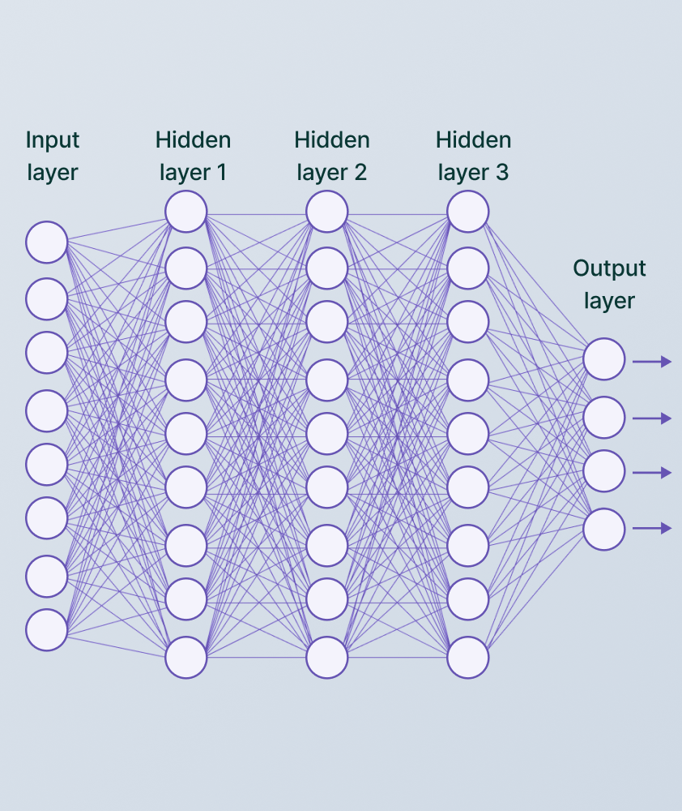
CONVOLUTION NEURAL NETWORKS
3 LAYER CNN MODEL

Slide 6
import numpy as np
import pandas as pd
import matplotlib.pyplot as plt
import seaborn as sns
import keras
from keras.models import Sequential
from keras.layers import Dense, Conv2D , MaxPool2D , Flatten , Dropout , BatchNormalization
from keras.preprocessing.image import ImageDataGenerator
from sklearn.metrics import classification_report,confusion_matrix
from keras.callbacks import ReduceLROnPlateau
CODE

Slide 7
train_df = pd.read_csv(r"C:\Users\shiva\Downloads\archive\sign_mnist_train.csv")
test_df = pd.read_csv(r"C:\Users\shiva\Downloads\archive\sign_mnist_test.csv")
test = pd.read_csv(r"C:\Users\shiva\Downloads\archive\sign_mnist_test.csv")
y = test['label']
y_train = train_df['label']
y_test = test_df['label']
del train_df['label']
del test_df['label']
from sklearn.preprocessing import LabelBinarizer
label_binarizer = LabelBinarizer()
y_train = label_binarizer.fit_transform(y_train)
y_test = label_binarizer.fit_transform(y_test)
CODE

Slide 8
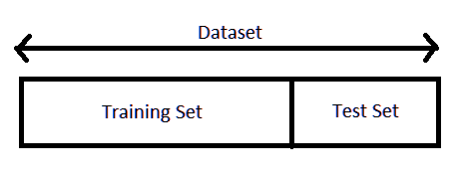
CODE

Slide 9
x_train = train_df.values
x_test = test_df.values
x_train = x_train / 255
x_test = x_test / 255
x_train = x_train.reshape(-1,28,28,1)
x_test = x_test.reshape(-1,28,28,1)
f, ax = plt.subplots(2,5)
f.set_size_inches(10, 10)
k = 0
for i in range(2):
for j in range(5):
ax[i,j].imshow(x_train[k].reshape(28, 28) , cmap = "gray")
k += 1
plt.tight_layout()
CODE

Slide 10
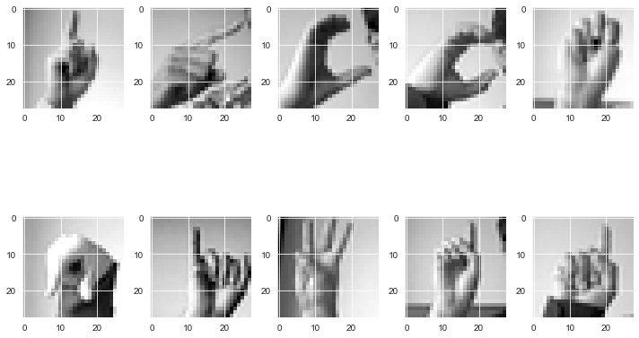
CODE

Slide 11
datagen = ImageDataGenerator(
featurewise_center=False,
samplewise_center=False,
featurewise_std_normalization=False,
samplewise_std_normalization=False,
zca_whitening=False,
rotation_range=10,
zoom_range = 0.1,
width_shift_range=0.1,
height_shift_range=0.1,
horizontal_flip=False,
vertical_flip=False)
datagen.fit(x_train)
learning_rate_reduction = ReduceLROnPlateau(monitor='val_accuracy', patience = 2, verbose=1,factor=0.5, min_lr=0.00001)
CODE

Slide 12


CONVOLUTION LAYER

Slide 13
CONVOLUTION LAYER

Slide 14
CONVOLUTION LAYER

Slide 15
CONVOLUTION LAYER

Slide 16
CONVOLUTION LAYER

Slide 17
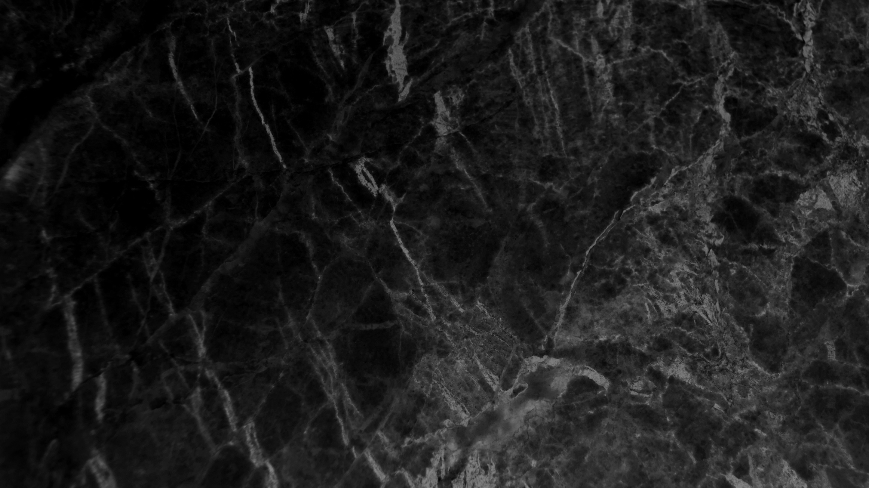

ACTIVATION FUNCTION LAYER
RECTIFIED LINEAR UNIT

Slide 18
model = Sequential()
model.add(Conv2D(75 , (3,3) , strides = 1 , padding = 'same' , activation = 'relu' , input_shape = (28,28,1)))
model.add(BatchNormalization())
model.add(MaxPool2D((2,2) , strides = 2 , padding = 'same'))
model.add(Conv2D(50 , (3,3) , strides = 1 , padding = 'same' , activation = 'relu'))
model.add(Dropout(0.2))
model.add(BatchNormalization())
model.add(MaxPool2D((2,2) , strides = 2 , padding = 'same'))
model.add(Conv2D(25 , (3,3) , strides = 1 , padding = 'same' , activation = 'relu'))
model.add(BatchNormalization())
CODE

Slide 19
model.add(MaxPool2D((2,2) , strides = 2 , padding = 'same'))
model.add(Flatten())
model.add(Dense(units = 512 , activation = 'relu'))
model.add(Dropout(0.3))
model.add(Dense(units = 24 , activation = 'softmax'))
CODE

Slide 20
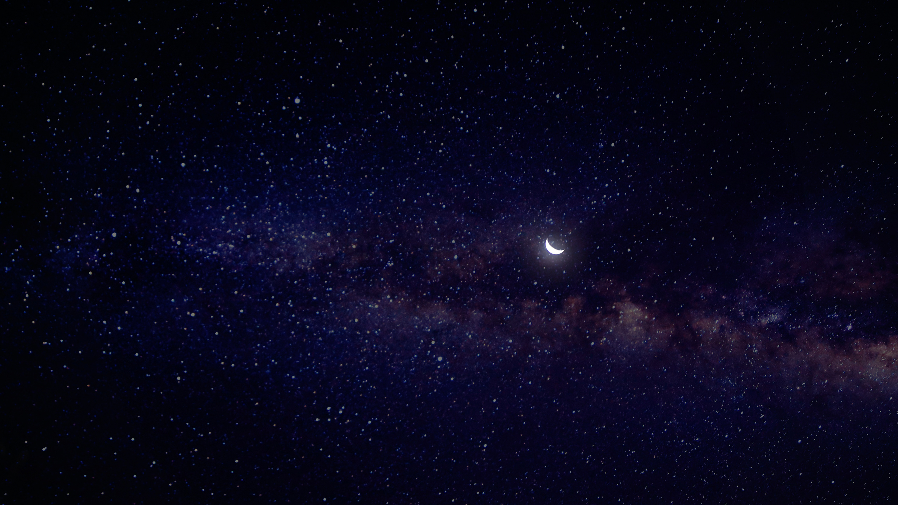
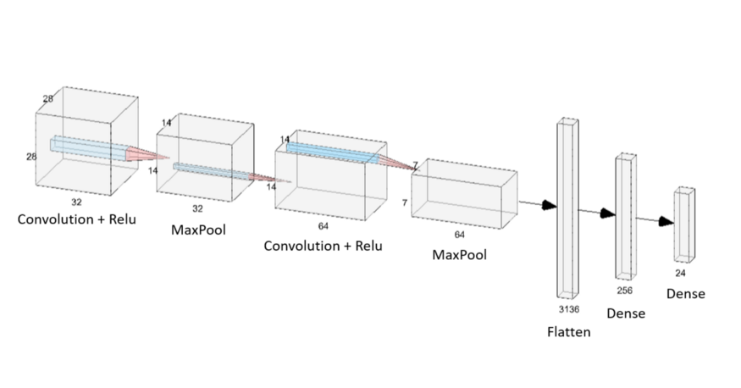

Slide 21
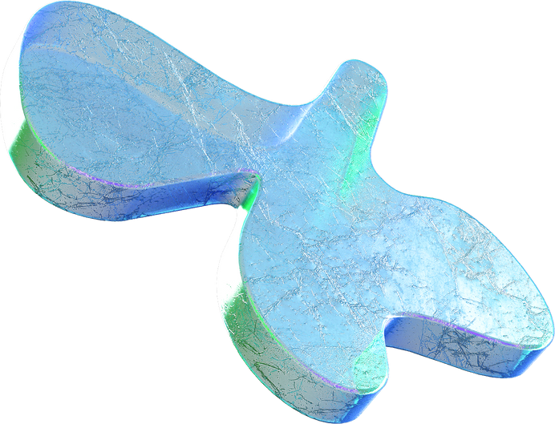
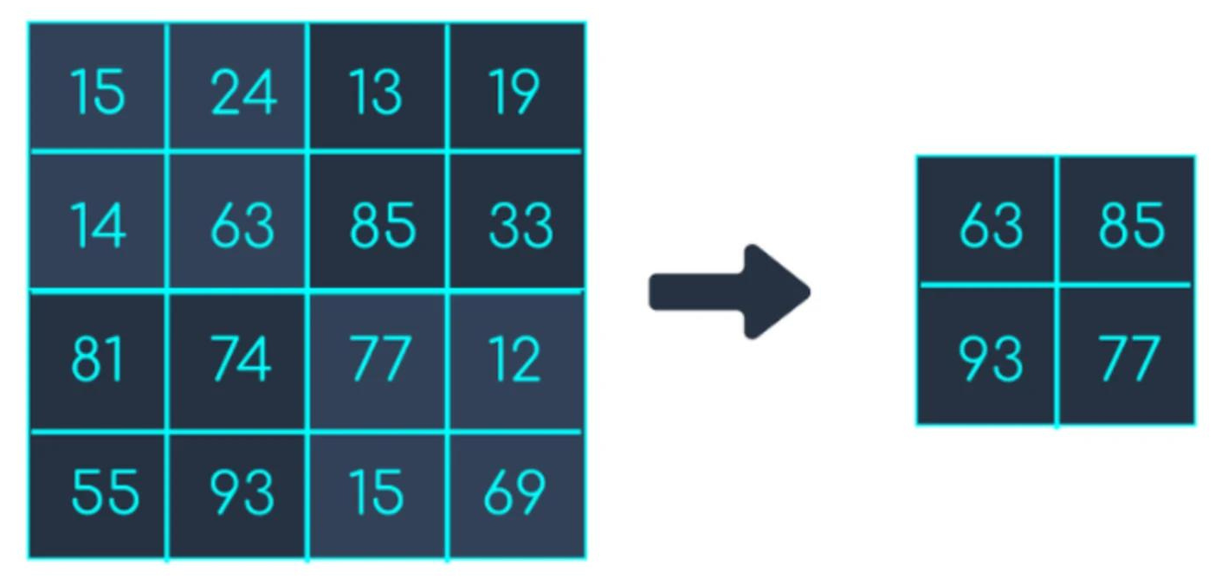
MAX POOLING LAYER

Slide 22
model.compile(optimizer = 'adam' , loss = 'categorical_crossentropy' , metrics = ['accuracy'])
model.summary()
history = model.fit(datagen.flow(x_train,y_train, batch_size = 128) ,epochs = 20 ,
validation_data = (x_test, y_test) , callbacks = [learning_rate_reduction])
print("Accuracy of the model is - " , model.evaluate(x_test,y_test)[1]*100 , "%")
CODE

Slide 23
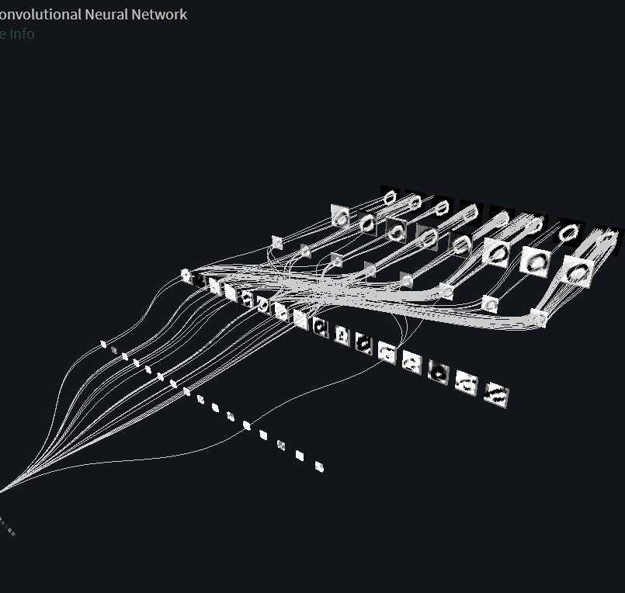
100 %
ACCURACY

Slide 24
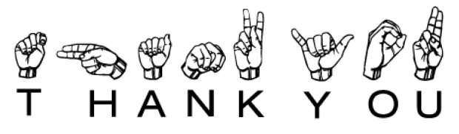
Do you have any questions?
Please feel free to ask us if there are any doubts.
Thank you!
TECH WIZARDS

